Slide 1
Feasibility In Business Case
Group 3

Slide 2
Content
What is Business Case
Steps required for a Business Case
Business Case Document
What Is Feasibility
How to do a Feasibility Study
Feasibility Study Types
Advantages of feasibility study

Slide 3
What Is Business Case
A business case is a project management document that explains how the benefits of a project overweigh its costs and why it should be executed.
A business case is an important project document to prove to your client, customer or stakeholder that the project you’re pitching is a sound investment.

Slide 4
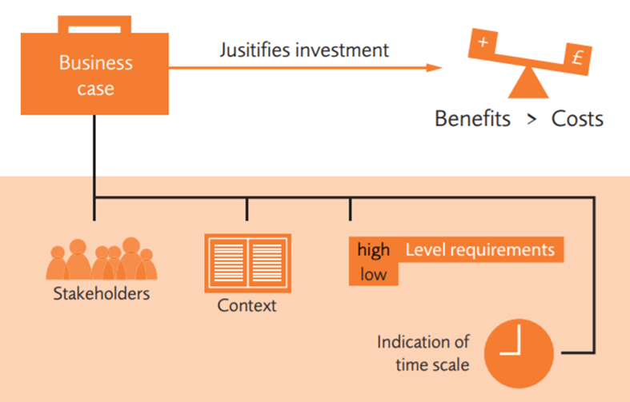

Slide 5
Steps required for a Business Case
Research Market, Competition and Alternatives.
Compare and Find different approaches.
Compile Data and Present Strategies.
Documentation.

Slide 6
Business Case Document
Executive Summary
Business Descriptive
Mission statement
Product or Service
Marketing Strategy.
Competition Analysis
SWOT Analysis
Operation Overview
Financial Statement

Slide 7
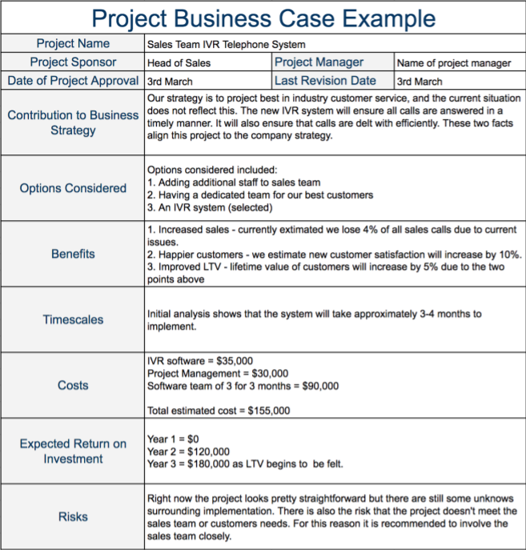

Slide 8
What Is Feasibility
This is an assessment of practicality of a proposed plan.
This is done after the Business Case.
This is done to determine the factors that need to make the business success.

Slide 9
How to do a Feasibility Study
Conduct Preliminary Study
Prepare Project income statement
Conduct Market Survey
Plan Business Organization and Operations.
Create opening day balance sheet
Review and Analyse
Make Go/No go decision

Slide 10
Feasibility Study Types
Technical Feasibility
Operational Feasibility
Economical Feasibility
Schedule Feasibility
Legal Feasibility

Slide 11
Advantages of feasibility study
With Feasibility Study, Project could get
Get Successful
Can Reach Goals and targets
Enhances the success rate
Can expand business
Narrow business alternatives
Identify valid reasons to follow the project
Identify valid reasons not to follow the project

Slide 12
Thank You

